Slide 1
T E N E T
P R E S E N T E D T O

Slide 2
Solar SD&D de México, LLC(SD&D) is a Mexico and US based company
committed to helping Mexico achieve its solar power potential and clean energy goals by taking an innovative approach to project development and finance. SDD has created a team of accomplished industry professionals with unparalleled knowledge of the Emerging Solar Markets to deliver CFE and Project Holders a competitive proposal for cost effective, large scale solar PV.
ABOUT US

Slide 3
ABOUT US
SD&D brings with it a demonstrated history of success working with Southern Company, and is again pleased to present this proposal to bring cost-effective, utility scale experience to CFE. With the end of the permit expiration drawing near, SD&D is prepared to move expeditiously to acquire all potential Solar PV projects prior to the PPA Signing Date of date of December 20, 2016. In contemplation of this deadline, D&D has prepared a turnkey EPC and Development Proposal along with construction financing. Our goal is to acquire a conglomerate of bankable projects on well located areas of power need. SD&D’s main goal is to provide CFE with a major utility scale roll out under the guidelines of the 2016-2018 utility scale auctions, whereby solar development costs are expected to rise significantly.

Slide 4
SITE ACQUISITION AND DEVELOPMENT SPECIALISTS
SD&D Greenbuilt, LLC (SDD) is a Georgia-based company committed to helping the southeast achieve its solar power potential and clean energy goals by taking an innovative approach to project development, construction and finance. SDD provides clients and partners with stable, low risk investments in advanced technology PV solar facilities and offers a broad range of renewable energy development and consulting services. SDD’s land development background provides unparalleled siteselection and due diligence for all sites, as well as extensive horizontal land development and site work performance.

Slide 5
Founded with the intention of developing large scale solar PV, SDD is on pace to achieve its objectives, and completed the development and sale of a three phase, 20 megawatt (MW), $60MM Georgia Power Company (GPC) solar project. The projects, which are the state’s first utility-scale solar developments, more than quadrupled Georgia’s total solar production of 2012. The success of this project has encouraged GPC to integrate more renewable energy assets into their overall energy portfolio and has positioned SDD to grow along with their expanding appetite for solar.
SDD has also partnered and consulted on 80Mw projects in both Arkansas and Alabama. Both were the largest projects in the state’s
history totaling $240,000,000 in investment.

Slide 6
SDD leveraged its familiarity with the Georgia solar market and relationship with GPC to create carefully structured projects that present the
key attributes necessary for success
We view the operation and maintenance of these first two solar assets as the
perfect stepping stone to reaching our long term objective of developing
high performing PV solar assets at the most cost competitive rates.

Slide 7
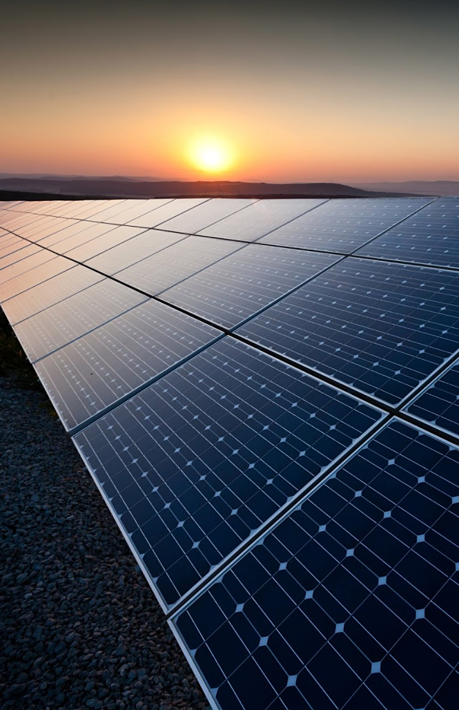
GEHRLICHER
SOLAR (EPC)
The Gehrlicher Group is an international photovoltaic company from Germany with project experience on four continents. It offers investors comprehensive support throughout the entire value chain. The group develops and realizes photovoltaic ground-mounted and roof-top systems from industrial buildings to multi-megawatt plants, integrates components from its own product family, GehrTec®, and offers tailor-made Operations and Maintenance services. In addition, the group offers profit-oriented private placement investments and photovoltaic funds for private and institutional capital investors. Gehrlicher Solar partnered with SDD on the Meriwether County Project for GPC, and did all preliminary engineering and cost analysis for the project before the project was sold. Gehrlicher’s strong financial background allows us to provide construction financing on all projects so we can deliver turnkey assets to our clients.

Slide 8
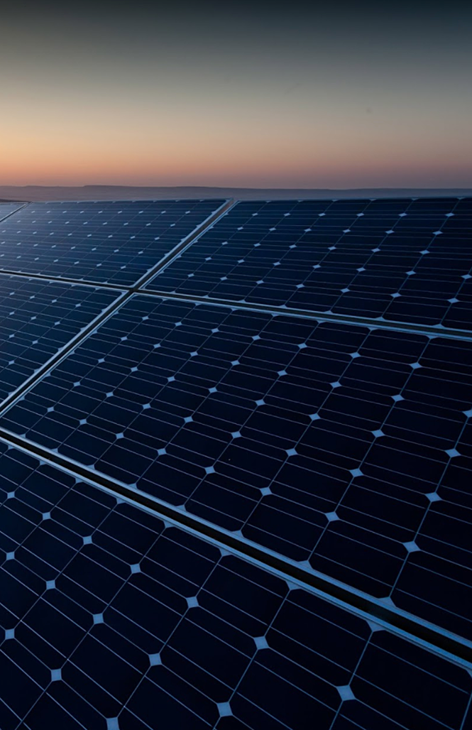
SHOALS
TECHNOLOGIES
(System Optimization)
Shoals Technologies Group is a leading manufacturer of balance of system solutions based in Portland, TN. Through innovation and diversification, Shoals has grown exponentially since its founding in 1996. Shoals maintains a diverse portfolio of PV balance of systems(“BOS”) products, including custom harness solutions, combiner/re-combiner boxes, master fuse boxes, junction boxes, PV wire, in-line fuses, racking and PV monitoring solutions.
Shoals was a full partner on all of SD&D’s projects in Georgia, and provided engineering and site optimization services along with all racking and balance of systems components.

Slide 9
OUR PROCESS
PROJECT DEVELOPMENT ANALYSIS
Creation of an effective project plan, makes even the most difficult project financeable, thus implementable
PROJECT STRUCTURING
Project structures are designed to maximize available subsidies for each project
Every project is individually analyzed in order to construct economic models
Models incorporate incentives, grants and subsidies to create cost efficient, and implementable renewable energy projects, which can then be marketed to the finance community
FINANCIAL ENGINEERING
Individual tax law, legal code, and utility companies make each U.S. state a unique energy market
Our comprehensive project models are tailored specifically to each market and provide a dynamic perspective of each project opportunity
Models depict the impact of individual project choices to the project’s financial yield

Slide 10
OUR PROCESS
EPC SELECTION
A sophisticated understanding of solar PV system design, construction management, and the international solar industry allows SD&D to identify the proper EPC for each project
Familiarity with local, national and international EPCs allows SD&D to drive project cost efficiency, & ensure system performance through a competitive bid process
IMPLEMENTATION
Extensive experience in project management and general contracting leads to the development of “shovel ready” projects designed with ease of installation in mind

Slide 11
CASH OUTLAY AND PROFIT MARGIN TURNKEY EPC/DEVELOPMENT COST
Inputs | $/MW | Total
Cancun Airport Site – 300MW (AC) 376.5MW (DC)
EPC Price/ watt (DC) | $1.2 | $360,000,000
Ratio (AC:DC) | 1.255
TOTAL BUILD COST*** |  | $451,800,000
***Total Build Cost does not include site cost if sale and not lease, but does assume a $4,600,000 total interconnection allowance, land, and site work.

Slide 12
OPTION 1: TURNKEY EPC/DEVELOPMENT PROFIT ON SALE
Inputs | $/MW | Total
Cancun Airport Site – 300MW (AC) 376.5MW (DC)
Total Build Cost*** | $1.2 | $451,800,000
Actual Turnkey Cost | $1.026 | $386,289,000
TOTAL DEVELOPMENT PROFIT |  | $65,511,000
***Total Build Cost does not include upfront site acquisition costs.

Slide 13
OPTION 2: LONG TERM OWNERSHIP
Inputs | $/MW
Total Turnkey Cost | $451,800,000
Down Payment | $65,511,000
Total 20 Year Debt @4% | $386,289,000
Monthly Payment on Debt | $2,340,826
Total Monthly Revenue | $5,186,548
Total Monthly Profit | $2,845,722
Total Annual Profit | $34,148,664
Total 20 Year Debt Payments | $561,800,768
Total 20 Year Solar Revenue (.05% Degradation/.06PPA) | $980,257,656
Total 20 Year Profit | $418,456,888

Slide 14
BILL SMITH
BILL@SMITH.COM
+1 404 555 1212

